Slide 1
Surgical Critical Care Fellowship
University of Cincinnati
Section of Trauma, Acute Care Surgery, General Surgery, and Critical Care
Program Director: Krishna Athota, M.D.
Program Coordinator: Elizabeth Loechle

Slide 2
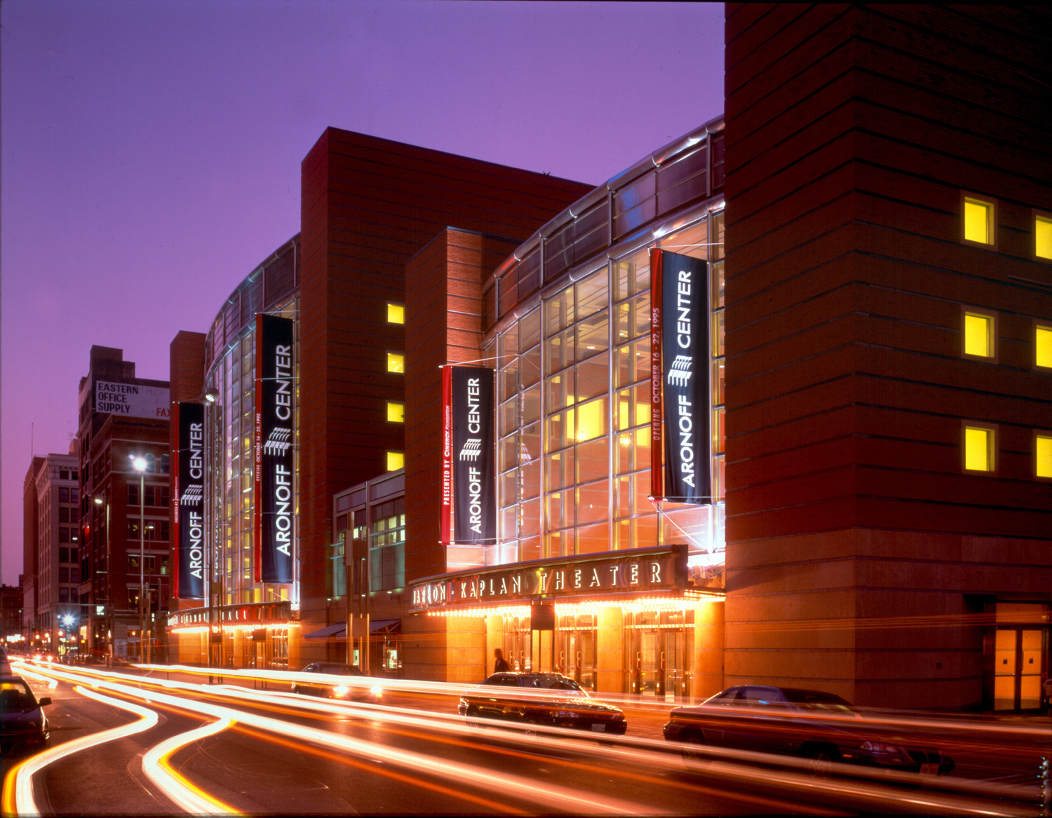

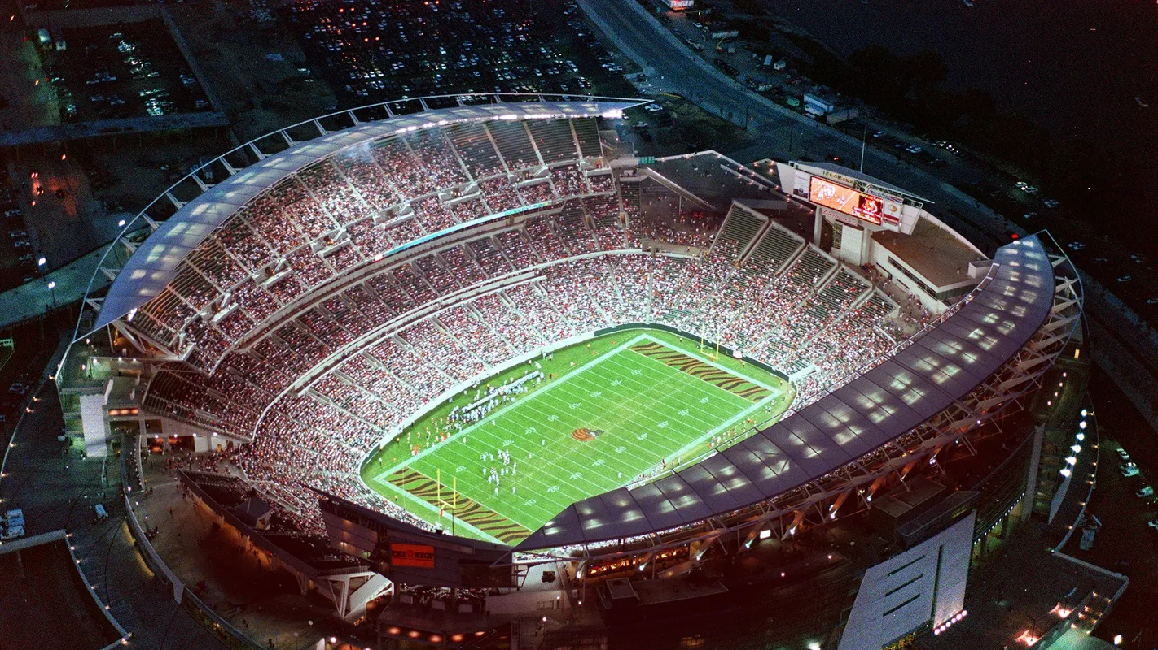

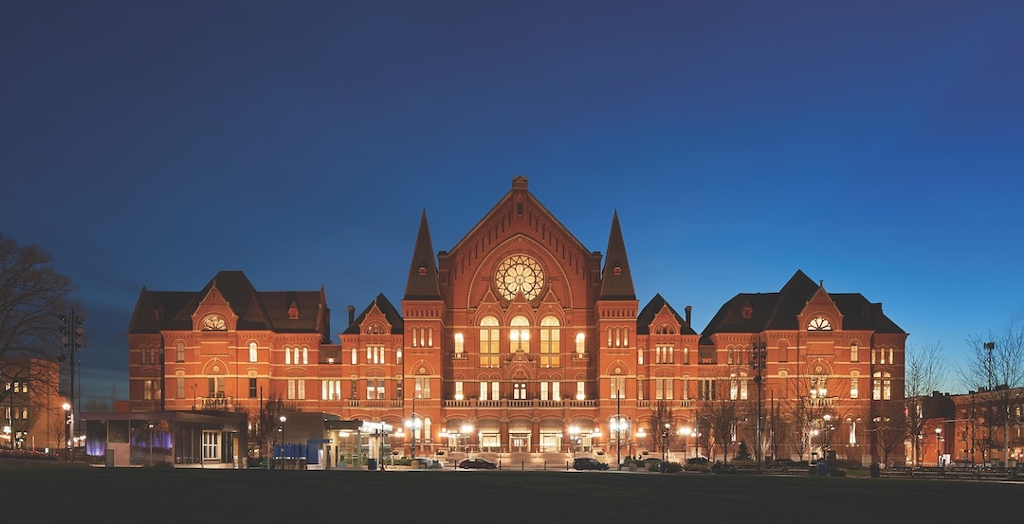




Cincinnati

Slide 3

Cincinnati

Slide 4


Slide 5
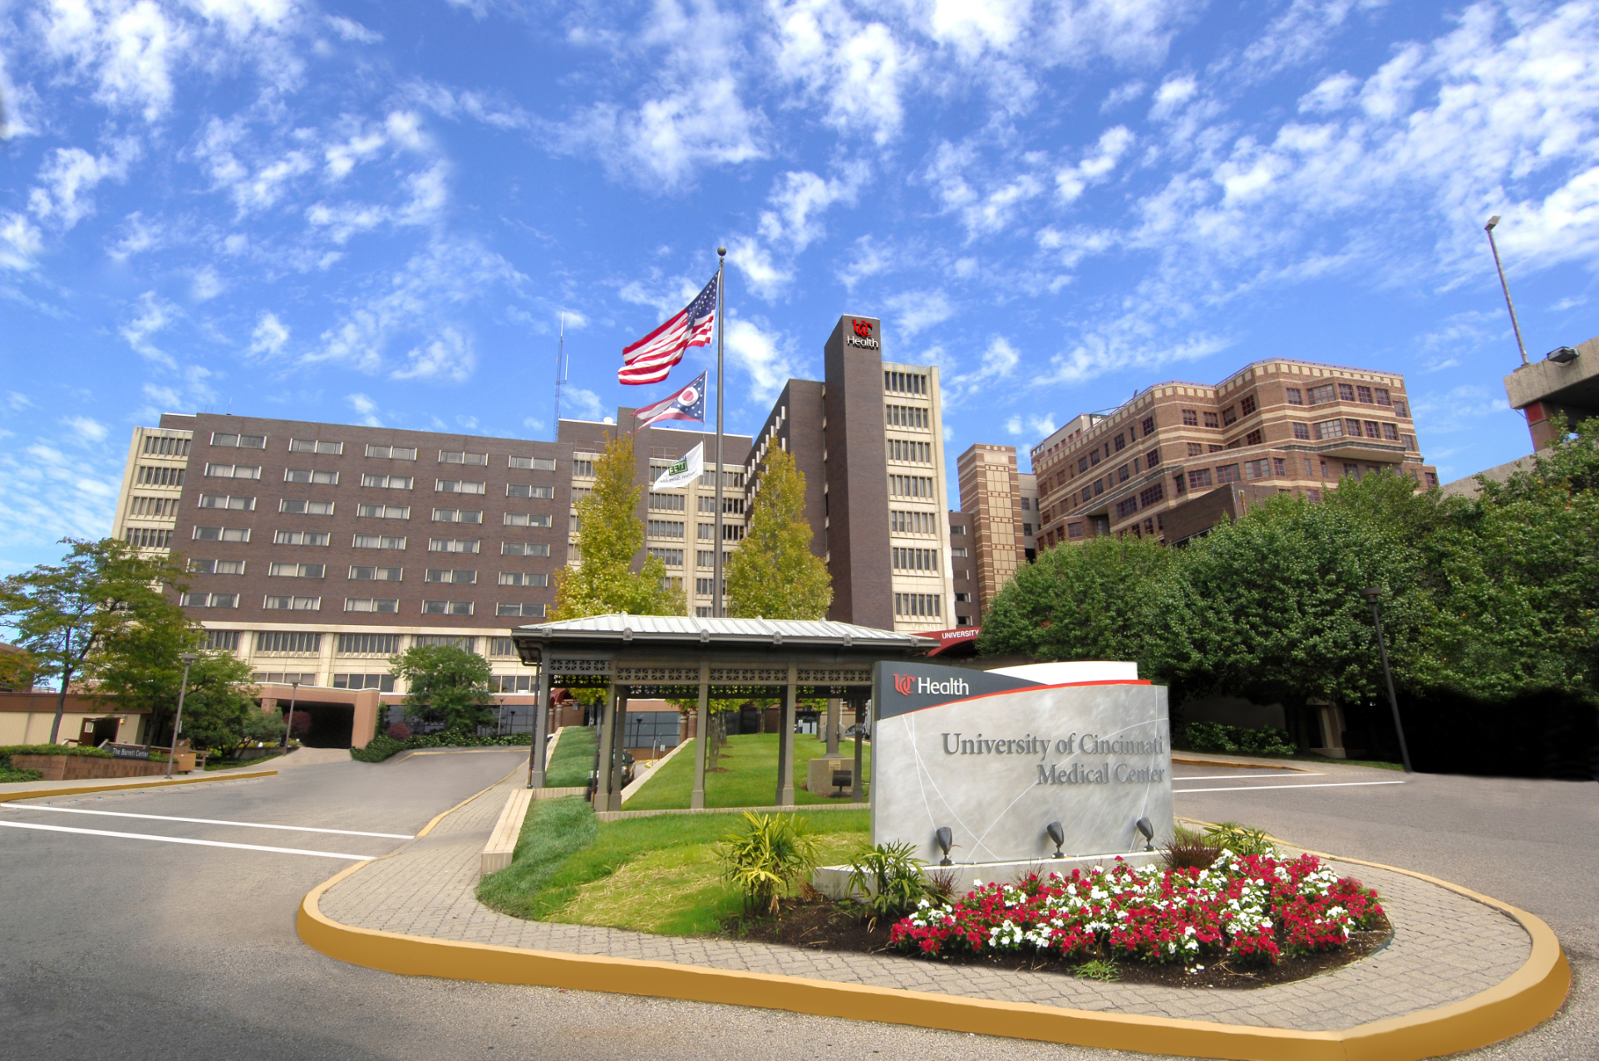
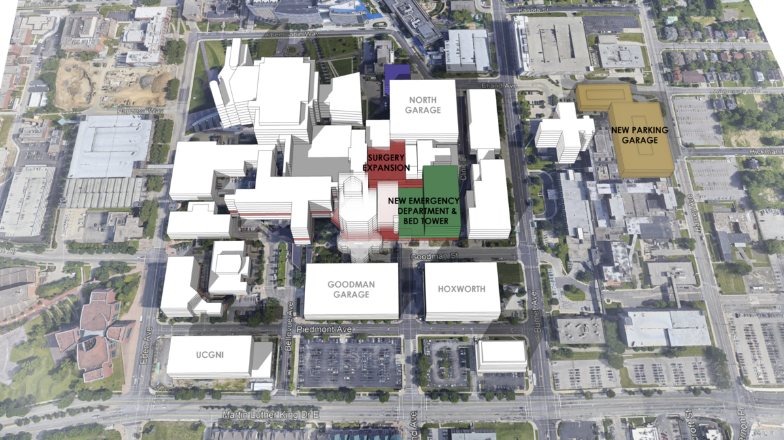

Slide 6
Trauma Statistics
Category | N
Trauma Encounters | 4000
Total Admissions | 2700
Admissions to Trauma Service | 1500
Penetrating | Avg 15% (Peak at 22%)
Trauma Cases done by our Faculty in 2019 | Over 500

Slide 7
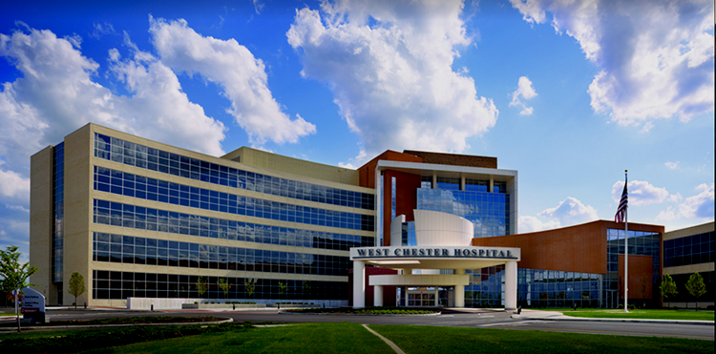
West Chester Hospital
Category | N
Trauma Encounters | 1039
Admissions | 657
Stat Activations | 96
Alert | 308
Consult | 438
Penetrating | 4%

Slide 8
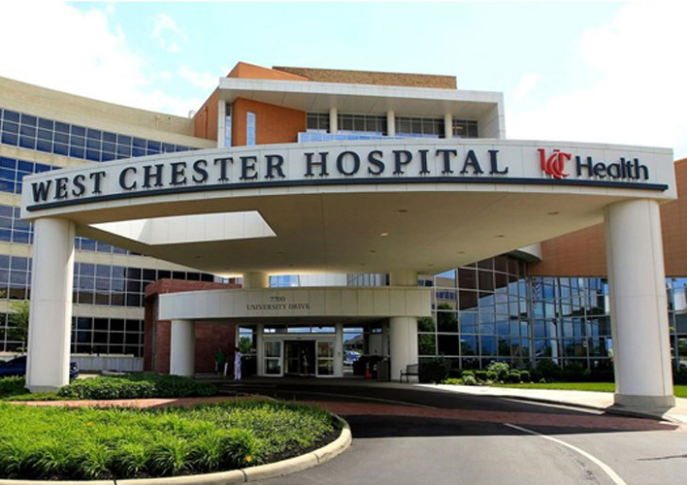
Additional Opportunities at WCH
Acute care surgery
General Surgery

Slide 9
REGISTRY VOLUME: | JAN | FEB | MAR | 1st QTR |  | APR | MAY | JUN | 2nd QTR |  | JUL | AUG | SEP | 3rd QTR |  | OCT | NOV | DEC | 4th QTR |  | TOTAL
ACS | 111 | 112 | 120 | 343 |  | 115 | 114 | 105 | 334 |  | 110 | 104 | 131 | 345 |  | 117 | 101 | 108 | 326 |  | 1348
* ACS Admissions | 103 | 108 | 111 | 322 |  | 106 | 111 | 96 | 313 |  | 106 | 101 | 122 | 329 |  | 112 | 101 | 99 | 312 |  | 1276
BURN | 18 | 17 | 16 | 51 |  | 15 | 16 | 22 | 53 |  | 21 | 18 | 11 | 50 |  | 15 | 15 | 14 | 44 |  | 198
UCMC TRAUMA | 320 | 273 | 317 | 910 |  | 337 | 390 | 386 | 1113 |  | 430 | 401 | 456 | 1287 |  | 377 | 375 | 308 | 1060 |  | 4370
* UCMC - VRC Cases | 246 | 217 | 239 | 702 |  | 263 | 307 | 301 | 871 |  | 322 | 306 | 332 | 960 |  | 285 | 283 | 231 | 799 |  | 3332
WCH TRAUMA | 85 | 67 | 76 | 228 |  | 94 | 98 | 82 | 274 |  | 101 | 77 | 87 | 265 |  | 96 | 87 | 90 | 273 |  | 1040
* WCH - VRC Cases | 63 | 50 | 63 | 176 |  | 79 | 68 | 51 | 198 |  | 76 | 49 | 56 | 181 |  | 60 | 61 | 63 | 184 |  | 739
Total Patients: | 534 | 469 | 529 | 1532 |  | 561 | 618 | 595 | 1774 |  | 662 | 600 | 685 | 1947 |  | 605 | 578 | 520 | 1703 |  | 6956

Slide 10
Fellowship Structure
My philosophy
  1 year versus 2 year
  You are not a resident
  Surgical vs Pulmonary vs Anesthesia critical care
  Graduated Level of responsibility

Slide 11
Overall Structure
One year ACGME accredited
  Critical Care fellowship
Two year non ACGME accredited
  Critical Care fellowship + second year of Junior faculty responsibilities with additional training in desired areas.
  Exposure to administrative responsibilities as an Assistant Trauma Medical Director at WCH.
  .

Slide 12
Basic Structure
SICU 8 Blocks
MICU 1 Block
PICU 1/2 Block
NSICU 1/2 Block
CVICU 1 Block
Elective / Trauma 2 Blocks

Slide 13
Block Schedule 2020-2021
2020 - 2021 Critical Care Fellows Composite Schedule
 | #1 |  | #2 |  | #3 |  | #4 |  | #5 |  | #6 |  | #7 |  | #8 |  | #9 |  | #10 |  | #11 |  | #12 |  | #13 |  | #1
 | 6/29/20 |  | 7/27/20 |  | 8/24/20 |  | 9/21/20 |  | 10/19/20 |  | 11/16/20 |  | 12/14/20 |  | 1/11/21 |  | 2/8/21 |  | 3/8/21 |  | 4/5/21 |  | 5/3/21 |  | 5/31/21 |  | 6/28/21
 |  |  |  |  |  |  |  |  |  |  |  |  |  |  |  |  |  |  |  | 3/22/21 |  | 4/19/21 |  | 5/17/21
SICU | Laseur |  | Nathawami |  | Seitz |  | Nathawami |  | Seitz |  | Nathawami |  | Seitz |  | Nathawami |  | Seitz |  | Nathawami | Seitz | Seitz | Nathawami | Nathawami |  | Seitz |  | Seitz
 | Checovich |  | Seitz |  | Nathawami |  | Larder (NS) | Cacic (NS) | Bernardoni |  | MICU 3 |  | MICU 4 |  | Smith (NS) |  | Schnettler |  | Schnettler |  | Ham (NS) |  | MICU 1 |  | MICU 2 |  | Nathawami
 |  |  |  |  |  |  | MICU 5 |  |  |  |  |  |  |  | Bernardoni |  |  |  |  |  | MICU 9
NSICU |  |  |  |  | Bernardoni |  | Schnettler |  | MICU 4 |  |  |  |  |  | MICU 9 |  | MICU 1 |  | Seitz | Nathawami | MICU 2 |  | MICU 3
MICU |  |  |  |  |  |  | Seitz |  | Nathawami |  |  |  |  |  |  |  | Smith (NS) |  |  |  | Robinson (NS) |  | Bernardoni |  | Schnettler
CVICU |  |  |  |  |  | MICU 6 | MICU 8 | MICU 7 |  | MICU 9 | Smith (NS) |  |  |  |  |  |  |  | MICU 7 | MICU 5 | MICU 6 | MICU 5 |  | MICU 9 | MICU 8
 |  |  |  |  |  |  |  |  |  |  |  |  |  |  | Seitz |  | Nathawami
 |  |  |  |  |  |  |  |  |  |  | davis
Trauma/WCH |  |  |  |  |  |  |  |  |  |  | seitz |  | Nathawami |  |  |  |  |  |  |  |  |  | Seitz |  | Nathawami
Peds |  |  |  |  |  |  |  |  |  |  |  |  |  |  |  |  |  |  |  |  | Nathawami | Seitz

Slide 14
Integrated Education
Critical Care Lecture Series
Section Journal Club
Asset Course
ATLS Course Instructor Status
Ultrasound Course

Slide 15
How are we different?
Allow Fellows to take trauma call as “faculty”
Do not require in house call for ICU
Breadth of experience
  Trauma is 30-40%
  Surg Onc
  Transplant
  Acute Care Surgery
  Ortho, urology, OB, vascular, General Surgery

Slide 16
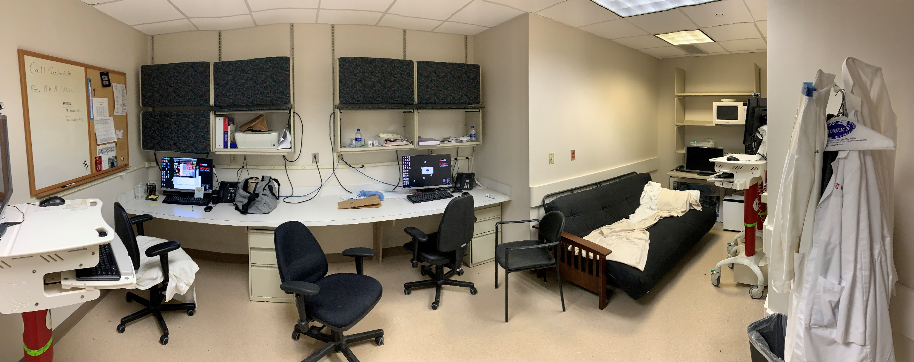
Fellow Call Room / Office

Slide 17
SICU Pods 1-3

Slide 18
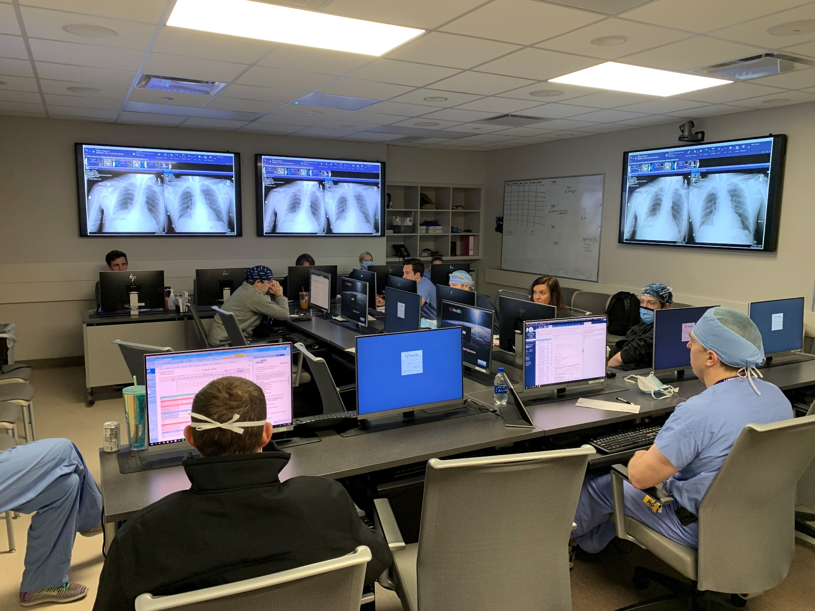
Trauma Rounds

Slide 19
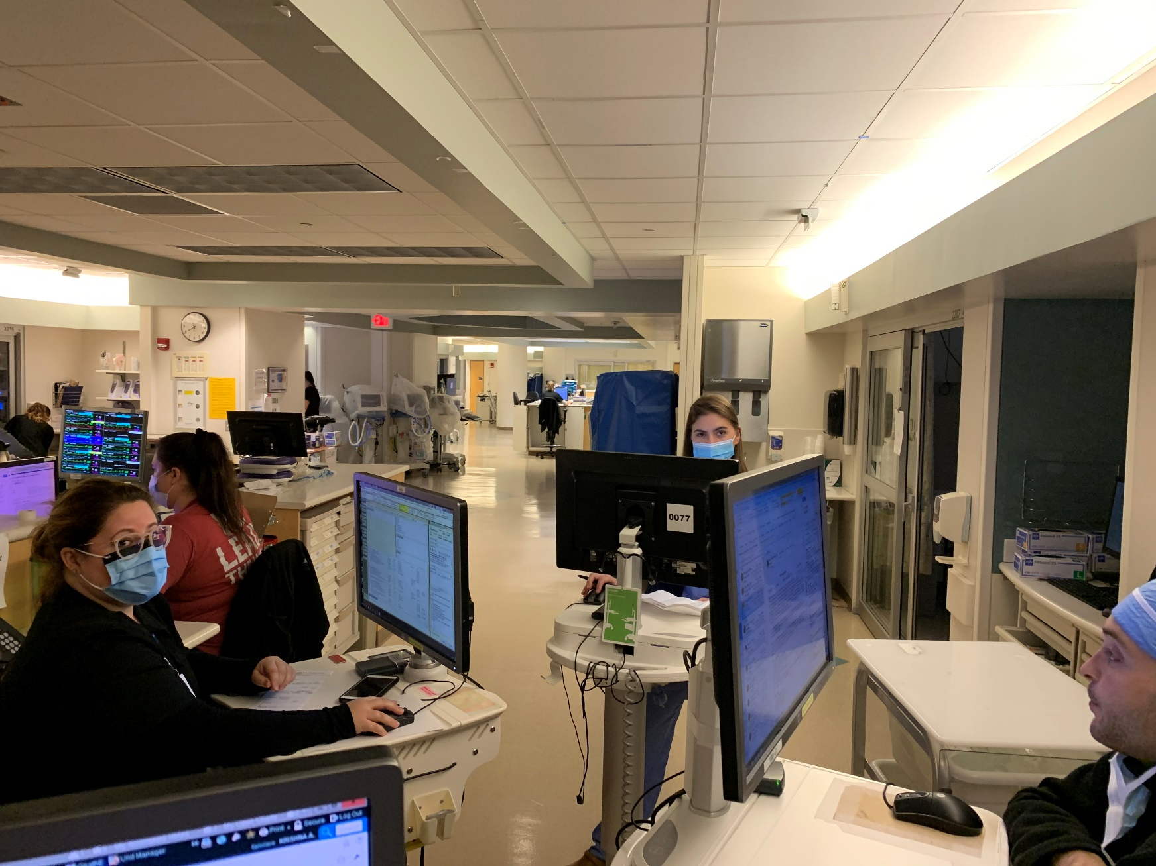
SICU Rounds

Slide 20
Goals for graduates
Technically skilled
Astute clinical acumen
Approachable and helpful
Educators

