Slide 1
The Cerebellum And Cognition
Federico Rodríguez-Porcel, MD

Slide 2
Objectives
Identify the regions of the cerebellum relevant to cognitive function.
Describe the cognitive processes in which the cerebellum is involved.
Discuss the involvement of the cerebellum in neurodegenerative diseases associated with cognitive impairment.

Slide 3
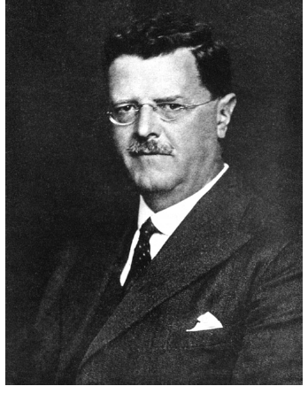
History
J.F.F. Babinski (1857-1932)
G. Holmes (1876-1965)

Slide 4
Study of 20 patients with diseases confined to the cerebellum.
Described a cerebellar cognitive affective syndrome characterized by impairments in:
Executive functions
Language
Visuospatial abilities
Changes in personality

Slide 5
Distributed Neural Circuits in Cognition
Catani M. et al. (2012)

Slide 6
Anatomy

Slide 7
Anatomy
Scherlf T. et al (2014)

Slide 8
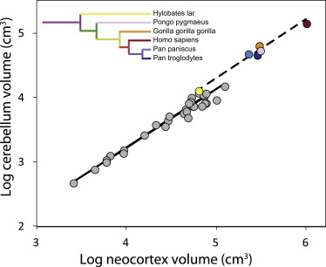
Cerebellum and Evolution
Increase of cerebellar volume has been proportional to increase of prefrontal cortex.
Humans have a significantly larger lobule VII and ventrolateral dentate nucleus compared to other primates.
Barton R. and Venditti C. (2012)

Slide 9
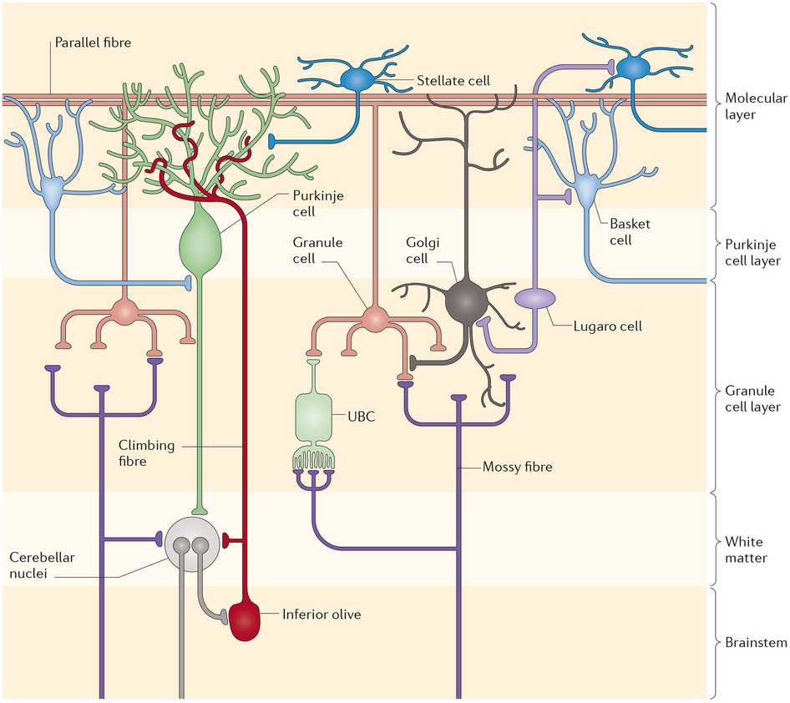
Cytoarchitecture
Cerminara N. et al. (2015)

Slide 10
Cerebellar Circuitry
Wisden W. et al. (2009)

Slide 11
Cerebellar Computational Models
Internal models
The cerebellum contains neural representations to emulate movement.
Forward model
The cerebellum influences the premotor system.
Inverse model
The cerebellum influences the motor system.
Adaptive filter
Components are weighted individually and then recombined to minimize the errors in performance caused by noise signal.
Cerebellar timer

Slide 12
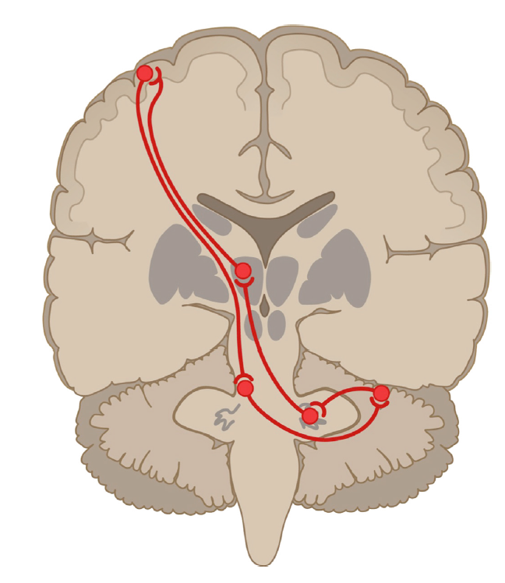
Cerebro-Cerebellar Pathways
Feedforward
Descending corticobulbar and corticospinal tracts via pontine nuclei to the cerebellar cortex.
Feedback
Ascending cerebellar tract via thalamus to the cerebral cortex.
Buckner R. (2013)

Slide 13
Sensorimotor Pathways
Afferents
From spinal cord via:
spinocerebellar tracts
Inferior olivary complex
From cerebral cortex
Motor nuclei of basis pontis
Project to:
Anterior lobe (lobules I-V)
Adjacent parts of lobule VI
Lobule VIII
Nuclei involved
Interpositus (globose and emboliform)
Dorsal part of dentate nucleus
Manni E. and Petrosini L. (2004)

Slide 14
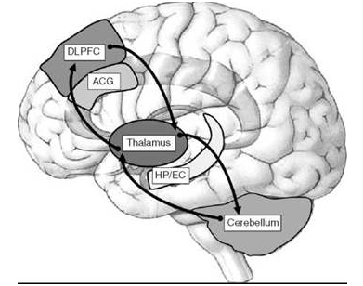
Cognitive/Behavioral Pathways
Afferents
Prefrontal cortex
Posterior parietal
Superior temporal
Dorsal parastriate cortices
Limbic afferents
Posterior parahippocampus
Cingulate gyrus
Anterior insular cortex
Project to:
Lobules VI and VII
Vermis of posterior lobe
Nuclei involved
Ventral and lateral dentate nucleus
Limbic and paralimbic areas interconnect with vermis and fastigial nucleus.

Slide 15
Cerebellar Subsystems
Manto M. and Marien P. (2015)

Slide 16
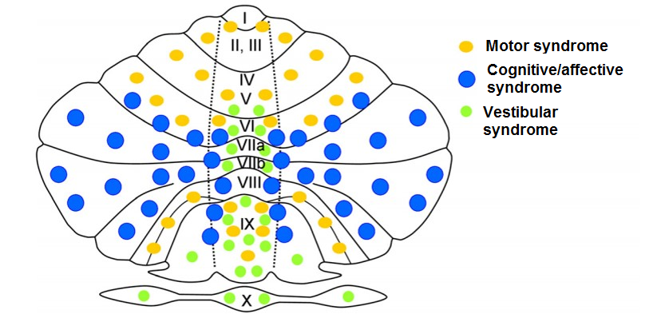
Symptoms of Cerebellar Disease
Manto M. and Marien P. (2015)

Slide 17
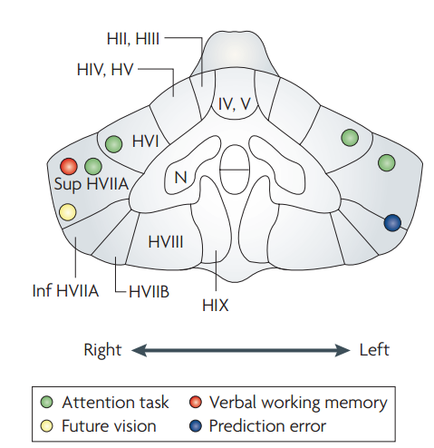
Attention
The dentate nucleus connects to oculomotor, prefrontal and posterior parietal cortex, all areas involved in attention.
Divided attention is more affected than sustained attention
Results are inconsistent.
Difficult to separate from its role in motor, oculomotor and working memory.
Ito M. (2008)

Slide 18
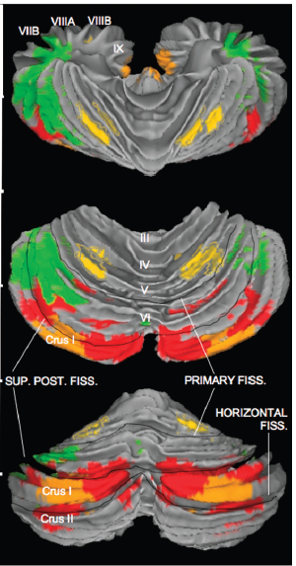
Executive Functions
Structural and functional connectivity of the cerebellum with prefrontal cortex.
Role in:
Working memory
Set-shifting
Inhibition
Phonemic fluency
Planning
Predicting outcome
Sequencing
Predominant region
Lobules VI and VII
Ventral and lateral dentate nucleus
Krienen F. and Buckner R. (2009)

Slide 19
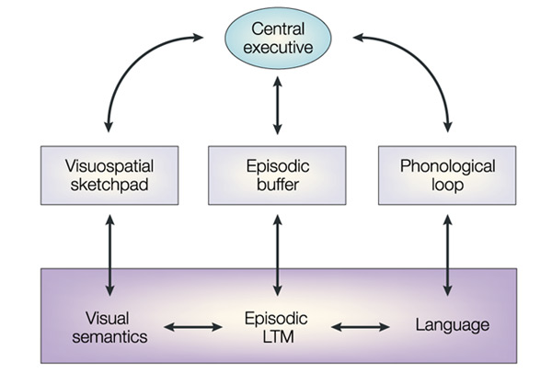
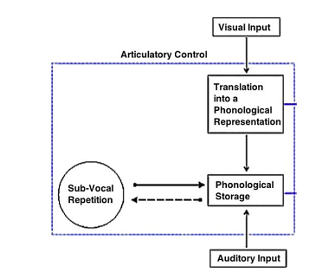
Executive Functions: Working Memory
Role of the cerebellum in sub-vocal repletion.
Verbal working memory may be more affected than spatial.
More pronounced with damage to right cerebellum.
Baddeley A. (2003)
Marien P. (2016)

Slide 20
Phonemic Fluency
Fan
Fang
Fancy
Fanciful
Fanfare
Fantastic
Fantasize
Fanatic
Fanaticism
Fanatically
Phonemic fluency is more impaired than semantic fluency
Phonemic clustering is common
Difficulty in category switching
Usually associated with right cerebellar hemispheric lesions

Slide 21
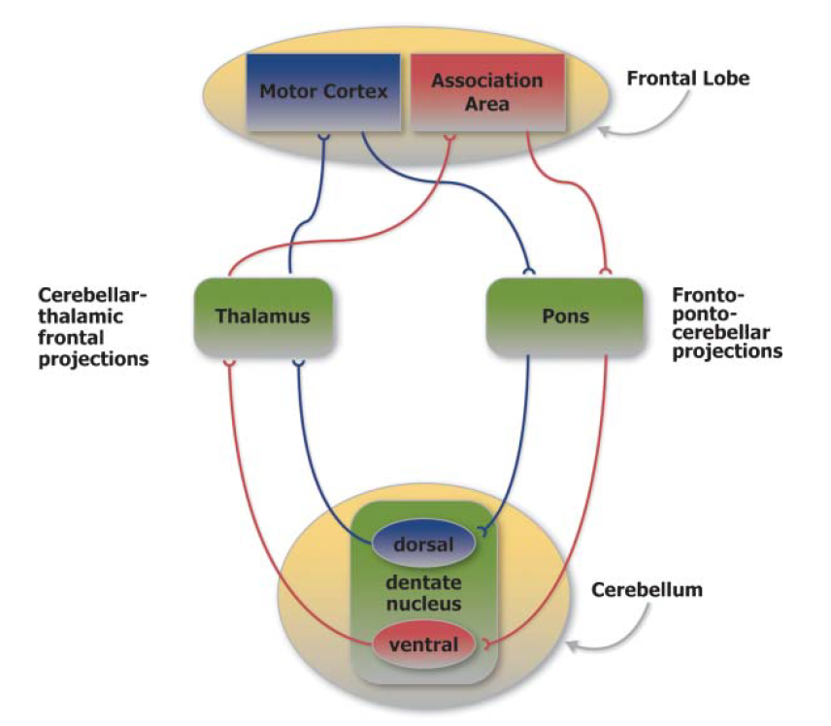
Language and Speech
Speech
Associated with anterior cerebellum
Deficits may present as:
Dysarthria
Apraxia of speech
Language
Syntax
Naming
Reading
Writing
Metalinguistic aspects
Highnam C. et al. (2011)
Notes:
Two circuits: one for planning and the other one for execution

Slide 22
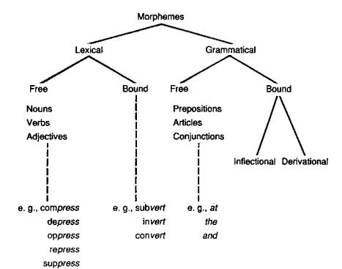
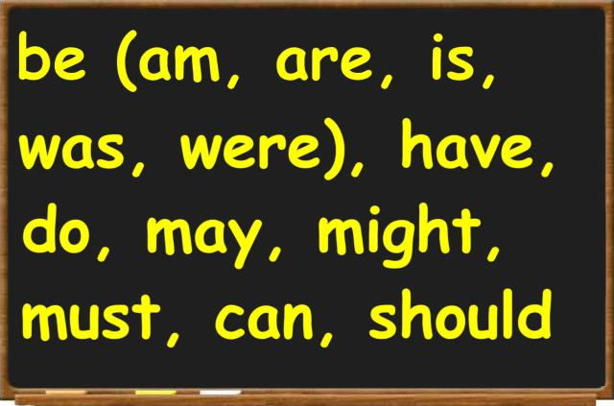
Syntax Processing
Implicated in grammar processing.
Omission of free standing grammatical morphemes.
Substitution of bound grammatical morphemes.
Omission of auxiliaries and clitics
Right cerebellum appears to play a more significant role
Notes:
free standing grammatical morphemes: Nouns, verbs, adjectives ({boy}, {buy}, {big}) are typical lexical morphemes. Prepositions, articles, conjunctions ({of}, {the}, {but}) are grammatical
morphemes. Bound inflectional (er-est)

Slide 23
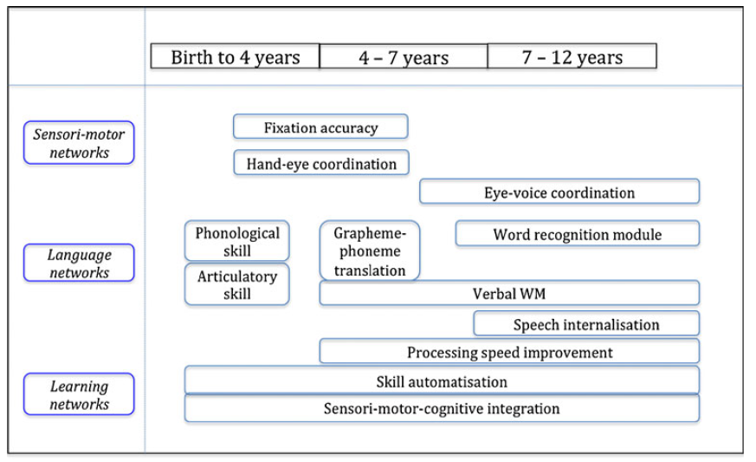
Other Language Features
Naming
Verbs worse than nouns
Reading
Lower degree of accuracy in reading words and sentences.
Increased frequency of errors at letter and word level.
Could be related to oculomotor abnormalities as well as other cognitive abnormalities.
Writing
Likely related to impaired motor programming and dysmetria.
Marien P. et al. (2013)

Slide 24
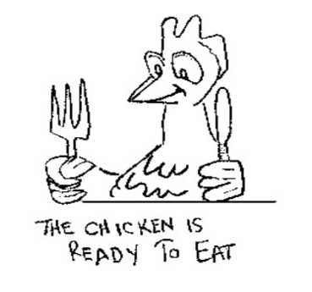
Metalinguistic Skills
Associated with left cerebellar lesions.
Impairments in distinguishing and defining homophones
Impaired understanding of figurative and ambiguous speech
Knight/night
We will be facing a hard road
The chicken is ready to eat

Slide 25
Visuospatial Abilities
Cerebellum projects to posterior parietal lobe and has a role in eye movement control
Role in:
Spatial attention
Visuospatial construction
Spatial navigation
Lesions are associated with:
Impairment in visual attention
Deficits in visual organization and visual construction.
Difficulties with mental rotation.
Impairment in visuospatial memory and working memory.
Simultagnosia
Predominant localization
Left hemisphere
Lobules VI-VII
Koziol L.,et al (2014)

Slide 26
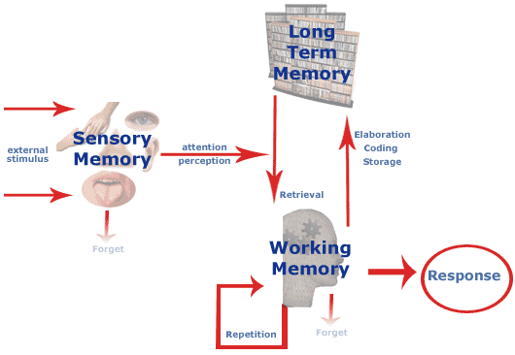
Memory
Cerebellum plays an important role in:
Procedural memory
Fear conditioning
Declarative memory
May be affected by executive dysfunction.
Retrieval deficit pattern.

Slide 27
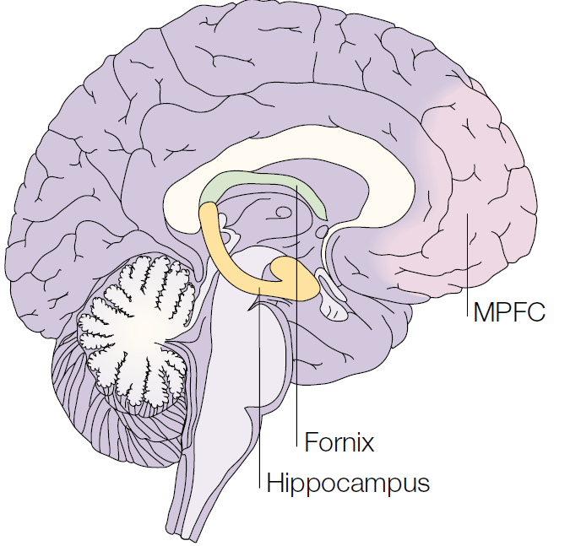
Personality Changes
Structural and functional connectivity with medial prefrontal cortex and hypothalamus
Associated in normal:
Inhibition
Emotional regulation
Emotional processing and empathy
Lesions lead to:
Changes in affect and initiative.
Aberrant modulation of behavior and personality
Disinhibited behaviors
Regressive, child like behaviors and obsessive compulsive traits.
Regions associated:
Posterior vermis
Fastigial nucleus
Simons J. and Spiers H. (2003)

Slide 28
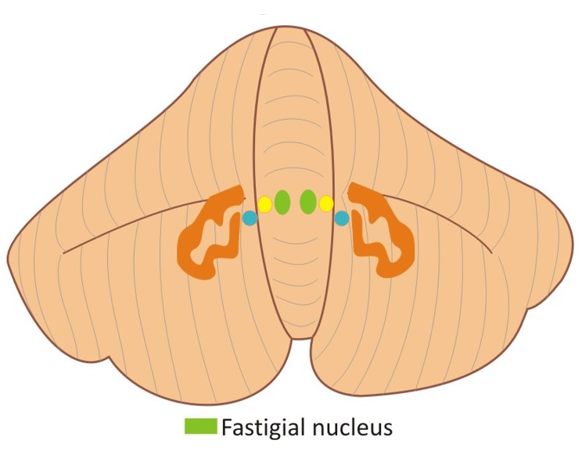
Affective Changes
Lesions involving vermis and fastigial nucleus.
Changes include
Anxiety
Blunted affect
Pathological laughing and crying.
Perez M. et al. (2012)

Slide 29
Neuropsychiatric Manifestations
Schmahmann J. (2014)

Slide 30
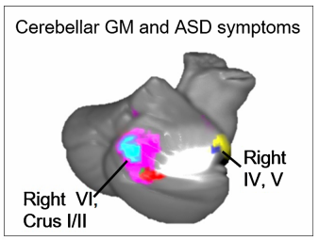
Proposed Neuropsychiatric Conditions Associated With Cerebellar Disease
Autism spectrum disorders
Attention-deficit/hyperactivity
Schizophrenia
Depression
Bipolar disorder
Stoodley C. (2016)

Slide 31
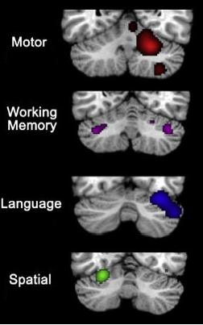
Summary
Sensorimotor cerebellum
Regions
Anterior cerebellum (I- adjacent VI)
Lobule VIII
Dorsal dentate
Involved in:
Motor control and programming
Cognitive cerebellum
Regions
Lobule VI and VII
Ventral and lateral dentate
Involved in:
Executive functions
Language (right hemisphere preference)
Visuospatial abilities (left hemisphere preference)
Limbic cerebellum
Regions:
Vermis of lobule VII
Fastigial nuclei
Involved in emotional regulation
Vestibular cerebellum
Regions:
Lobules IX and X
Stoodley C. et al. (2009)

Slide 32
Dysmetria of Thought
Guell X., et al. (2014)

Slide 33
The Spectrum of Cerebellar Manifestations

Slide 34
Two Syndromes
Cognitive Affective
Cerebellar Syndrome
Posterior Fossa Syndrome.
Impairments in
Executive function
Spatial cognition
Language deficits
Personality change
Seen in children 2-3 days after tumor resection
Mutism
Hypotonia
Buccal and lingual apraxia
Recovery is seen in a couple of months with residual dysarthria
Apathy and emotional lability may be present

Slide 35
Thank you
Do we have more time?

Slide 36
Spinocerebellar Ataxias
Described in:
SCA 1
SCA 2
SCA 3
SCA 6
SCA 8
SCA 10
SCA 12
Dementia is a prominent feature of:
SCA 17
DRPLA
Intellectual disability is associated with SCA 13

Slide 37
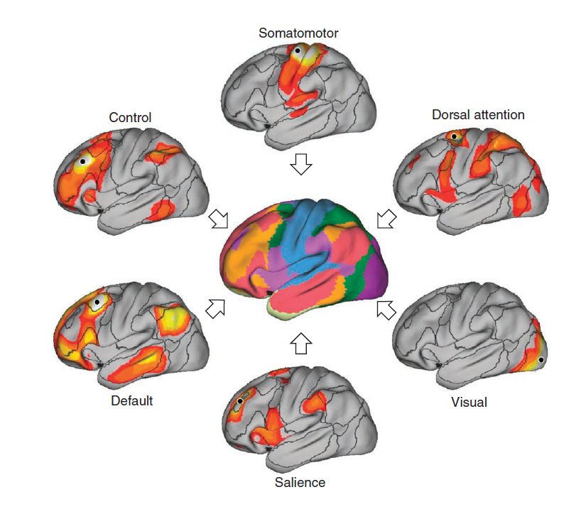
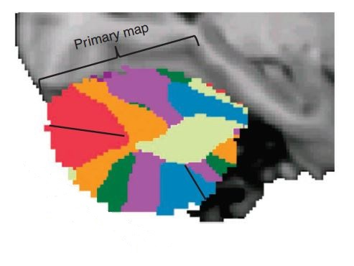
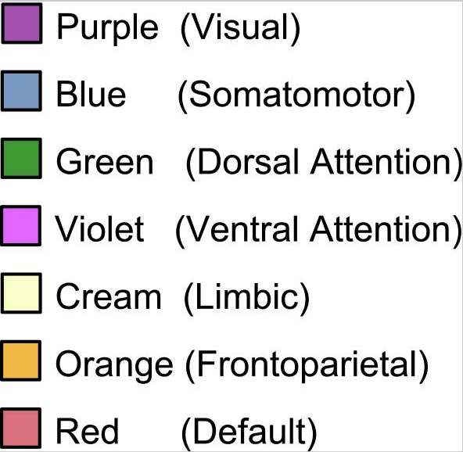
Resting Functional MRI
Buckner R., et al. (2013)

Slide 38
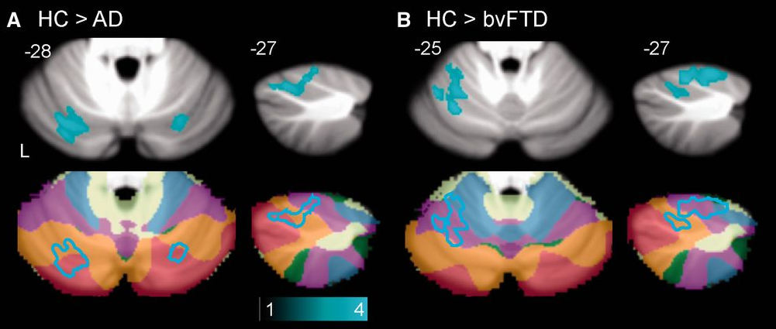
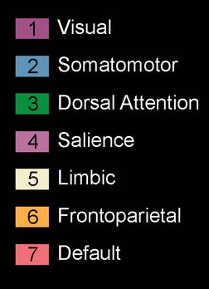
Patterns of Atrophy in Dementia
Alzheimer’s disease
Peak atrophy in Crus I (Lobule VII)
Degree of atrophy correlates with atrophy in angular gyrus
Behavioral variant FTD
Peak atrophy in lobule VI
Left predominance
Degree of atrophy correlates with atrophy in anterior insula
Guo C., et al (2016)

Slide 39
Cerebellum in Alzheimer Disease
Reduction of the total cerebellar volume.
May be present in MCI
Neurofibrillary tangles are usually absent
Amyloid plaques are present in advanced disease
Juckner M. and Walker L. (2011)

Slide 40
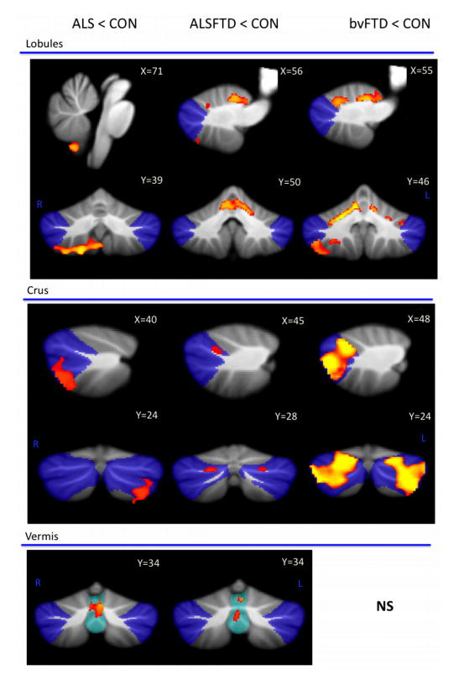
Cerebellum in ALS-bvFTD
Significant grey matter atrophy in the cerebellum across the whole ALS-bvFTD continuum
Atrophy predominantly of the superior cerebellum and crus I in bvFTD patients
Atrophy of the inferior cerebellum and vermis in ALS patients
ALS-bvFTD patients had both patterns of atrophy.
Tan R., et al. (2014)

Slide 41
Genetic Frontotemporal Dementia
C90rf72 gene mutation
Decreased cerebellar volume.
Significant atrophy in lobule VIIa-Crus I.
MAPT gene mutation
Significant lower vermian atrophy.
GRN gene mutation
No significant atrophy
Bocchetta M., et al (2016)

Slide 42
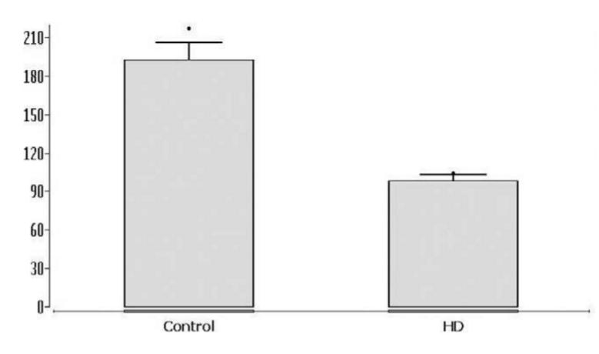
Huntington Disease
HD patients have significant loss of Purkinje cells
Early manifest HD patients exhibit lower right cerebellar lobule VIIa volume.
Other studies have found significant vermian atrophy compared to controls.
Rub U., et al (2012)

Slide 43
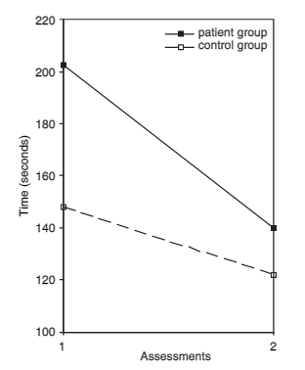
Recovery from Cerebellar Lesions
Recovery after cerebellar lesions is usually good.
Time of recovery spans from 4 to 12 months.
Deficits may be undetectable after recovery.
The unique role of cerebellar plasticity has been proposed as mechanism for its resilience.
Hokkanen L., et al. (2006)
Notes:
Copy of Rey figure 3 months after stroke

Slide 44
Thank you
No more slides, I promise.

